Slide 1


Uncertainty Quantification Functionality in MC/DC
Kayla Clements, Ilham Variansyah, Todd Palmer
The Center for Exascale Monte Carlo Neutron Transport (CEMeNT)
Oregon State University
April 25, 2024

Slide 2
Bottom Line, Up Front
An embedded uncertainty quantification method, variance deconvolution (Var-D), is implemented and tested in MC/DC.
Consistently more accurate and efficient than the standard sampling-UQ approach for stochastic solvers
Supported parameters: material and nuclide cross sections, some object dimensions
Takes advantage of MC/DC structure, including parallelization

Slide 3


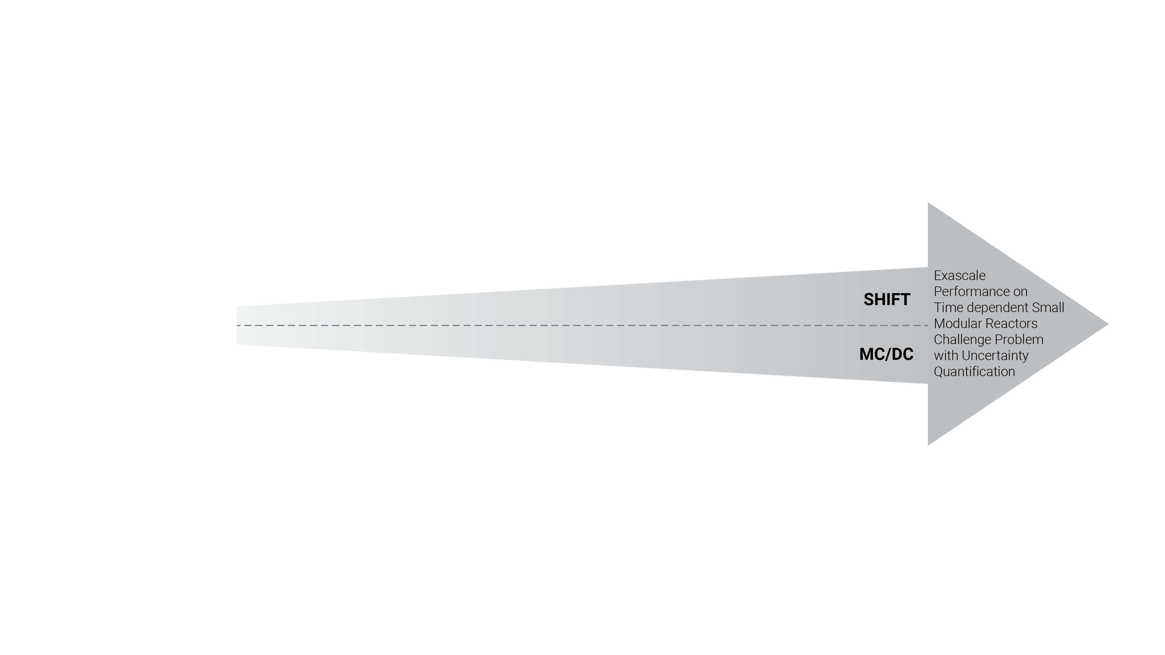

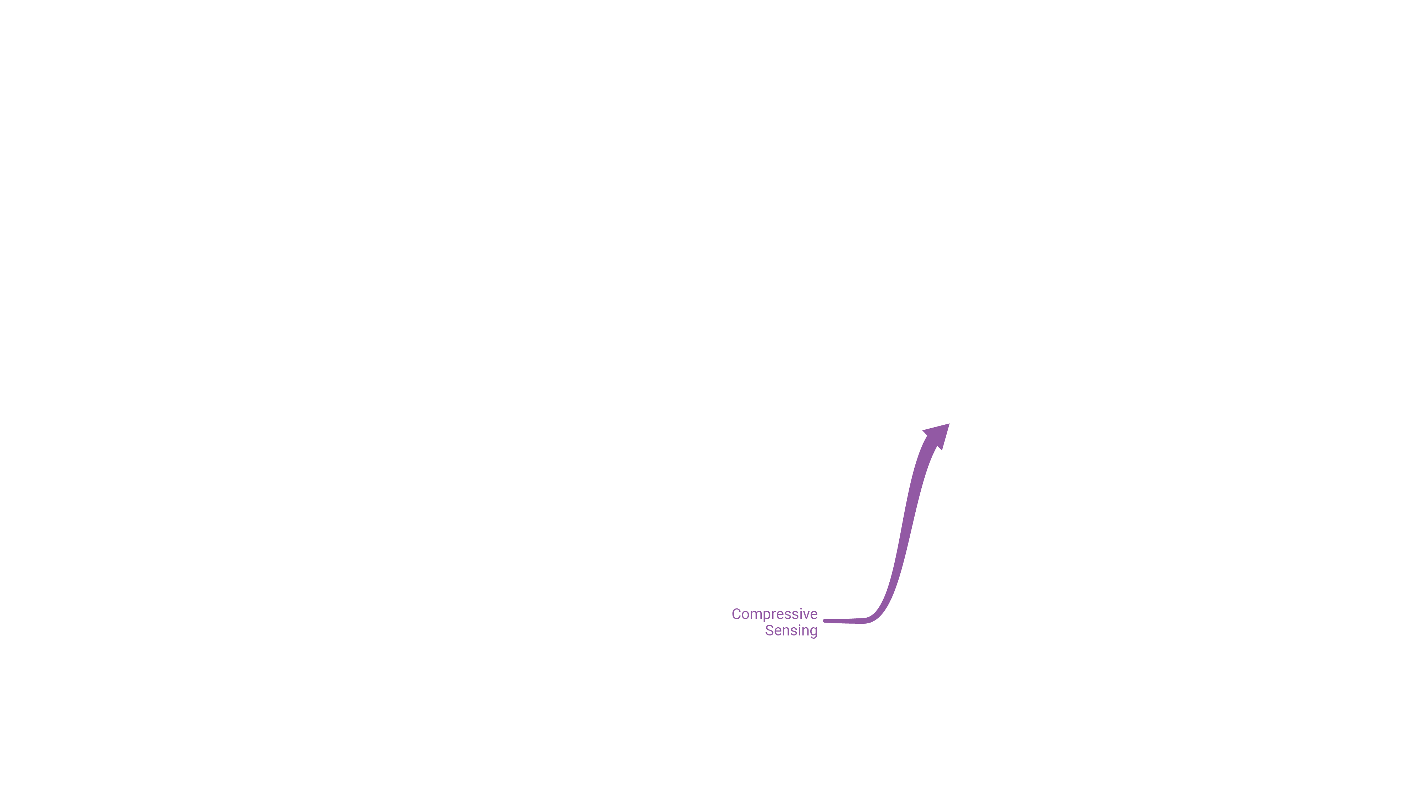
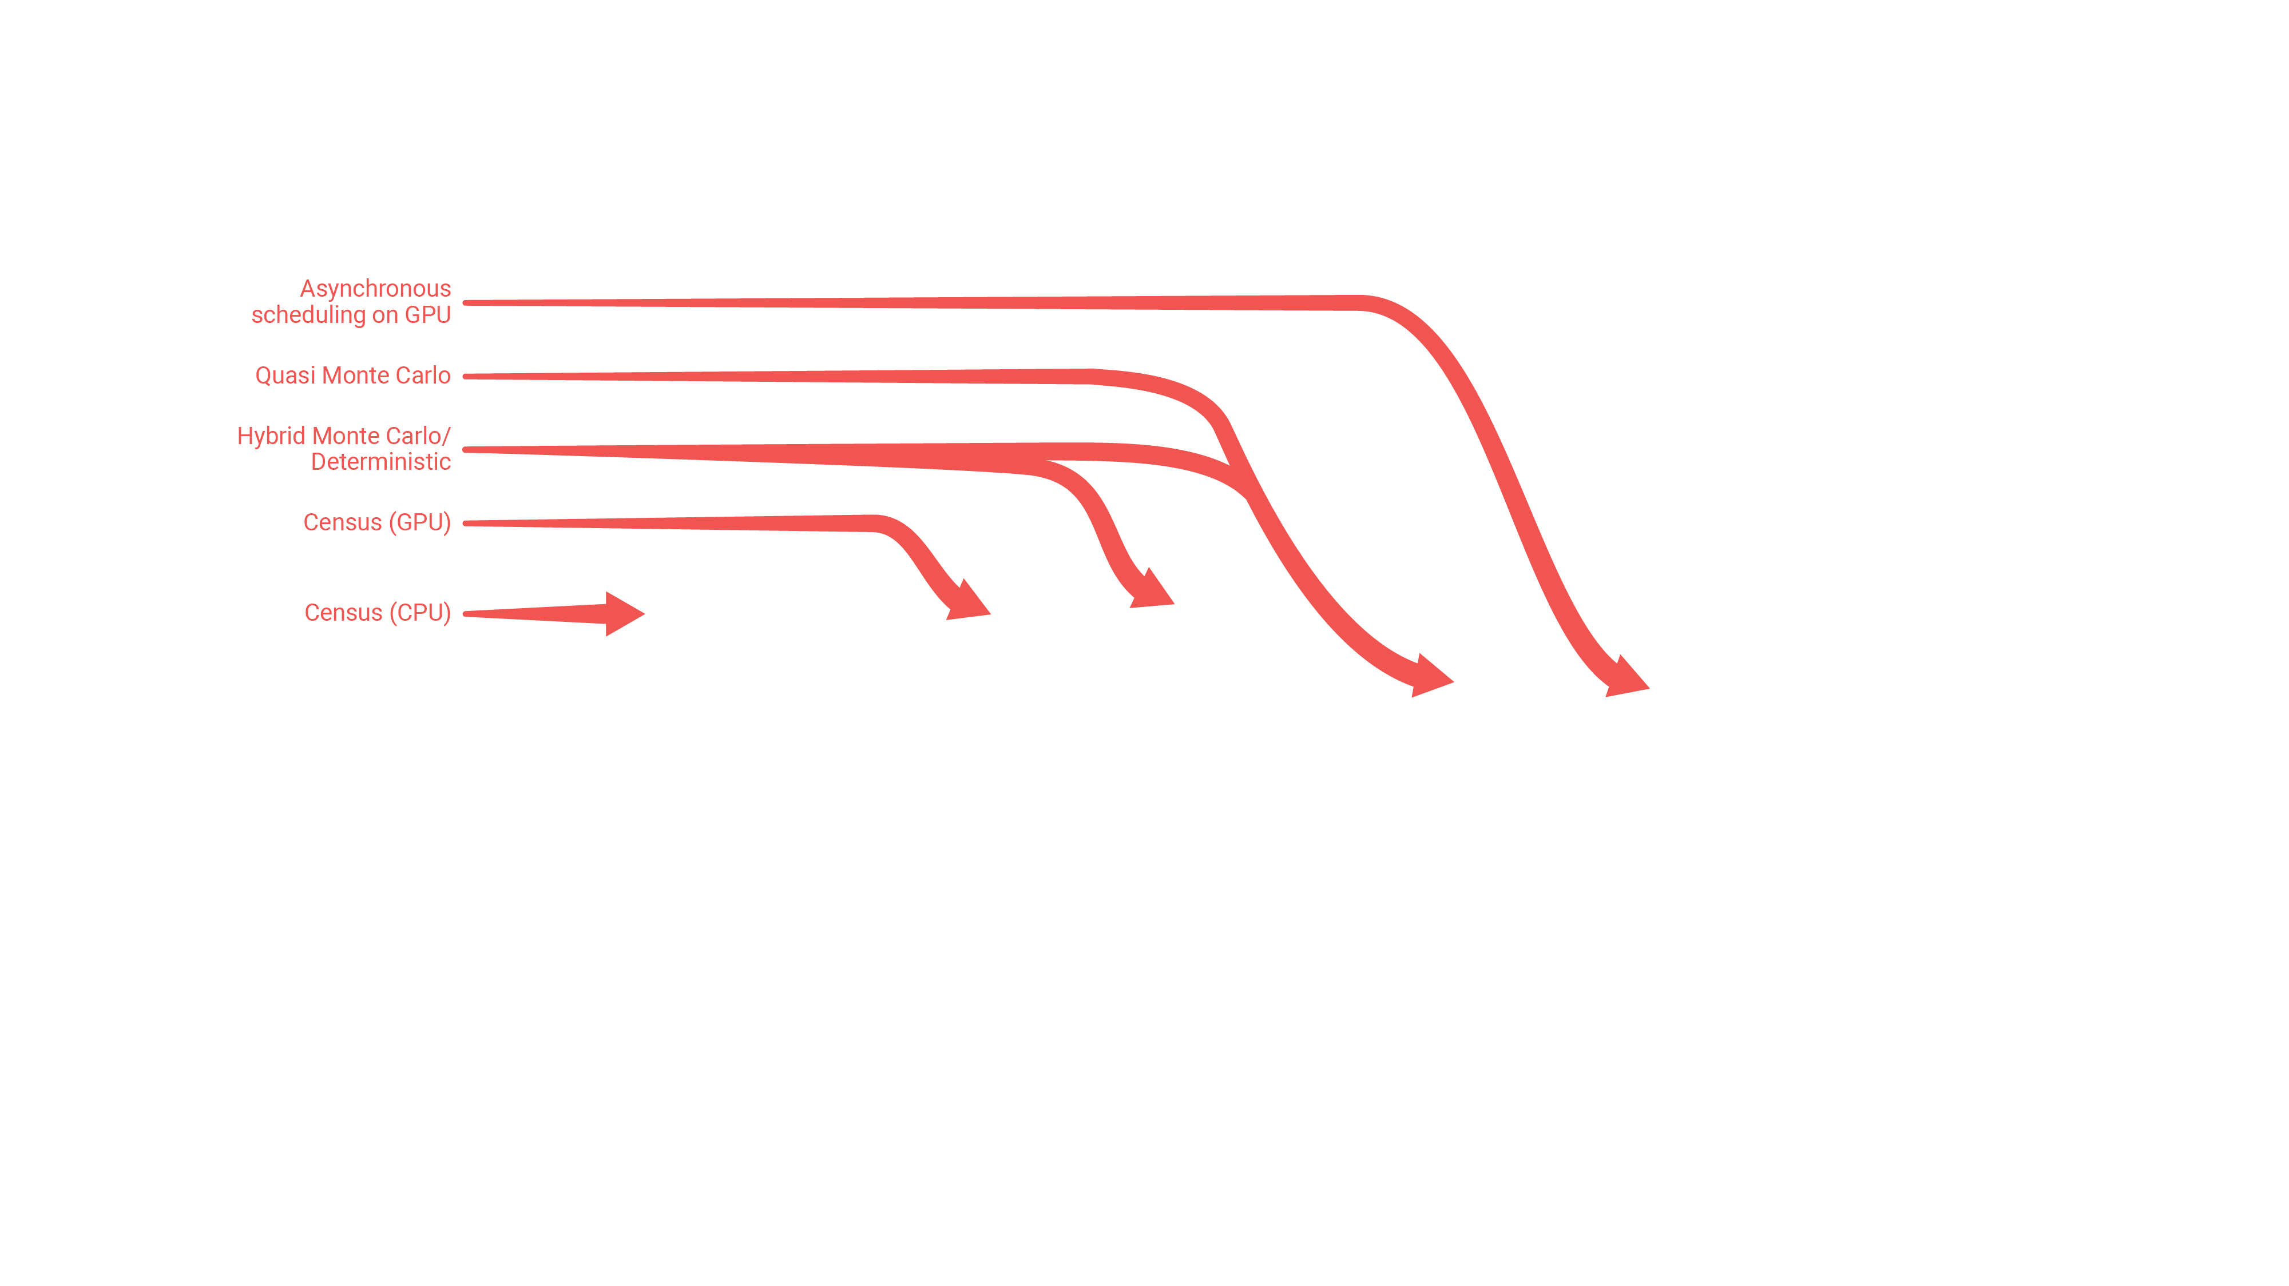
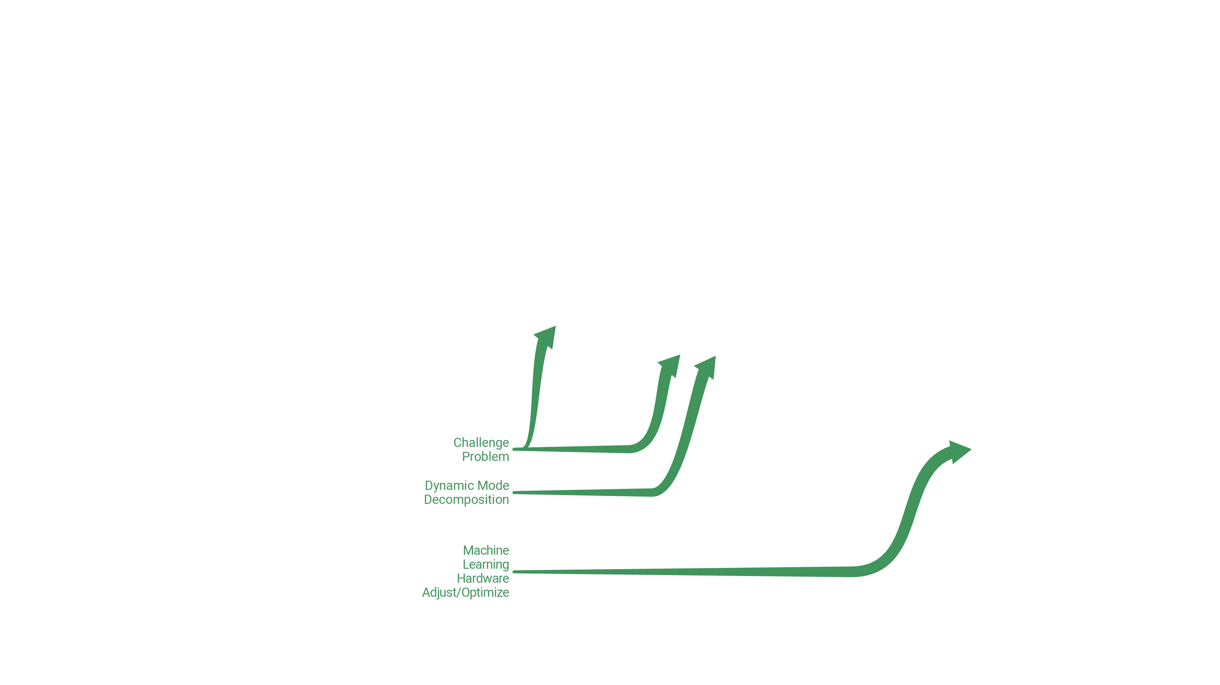
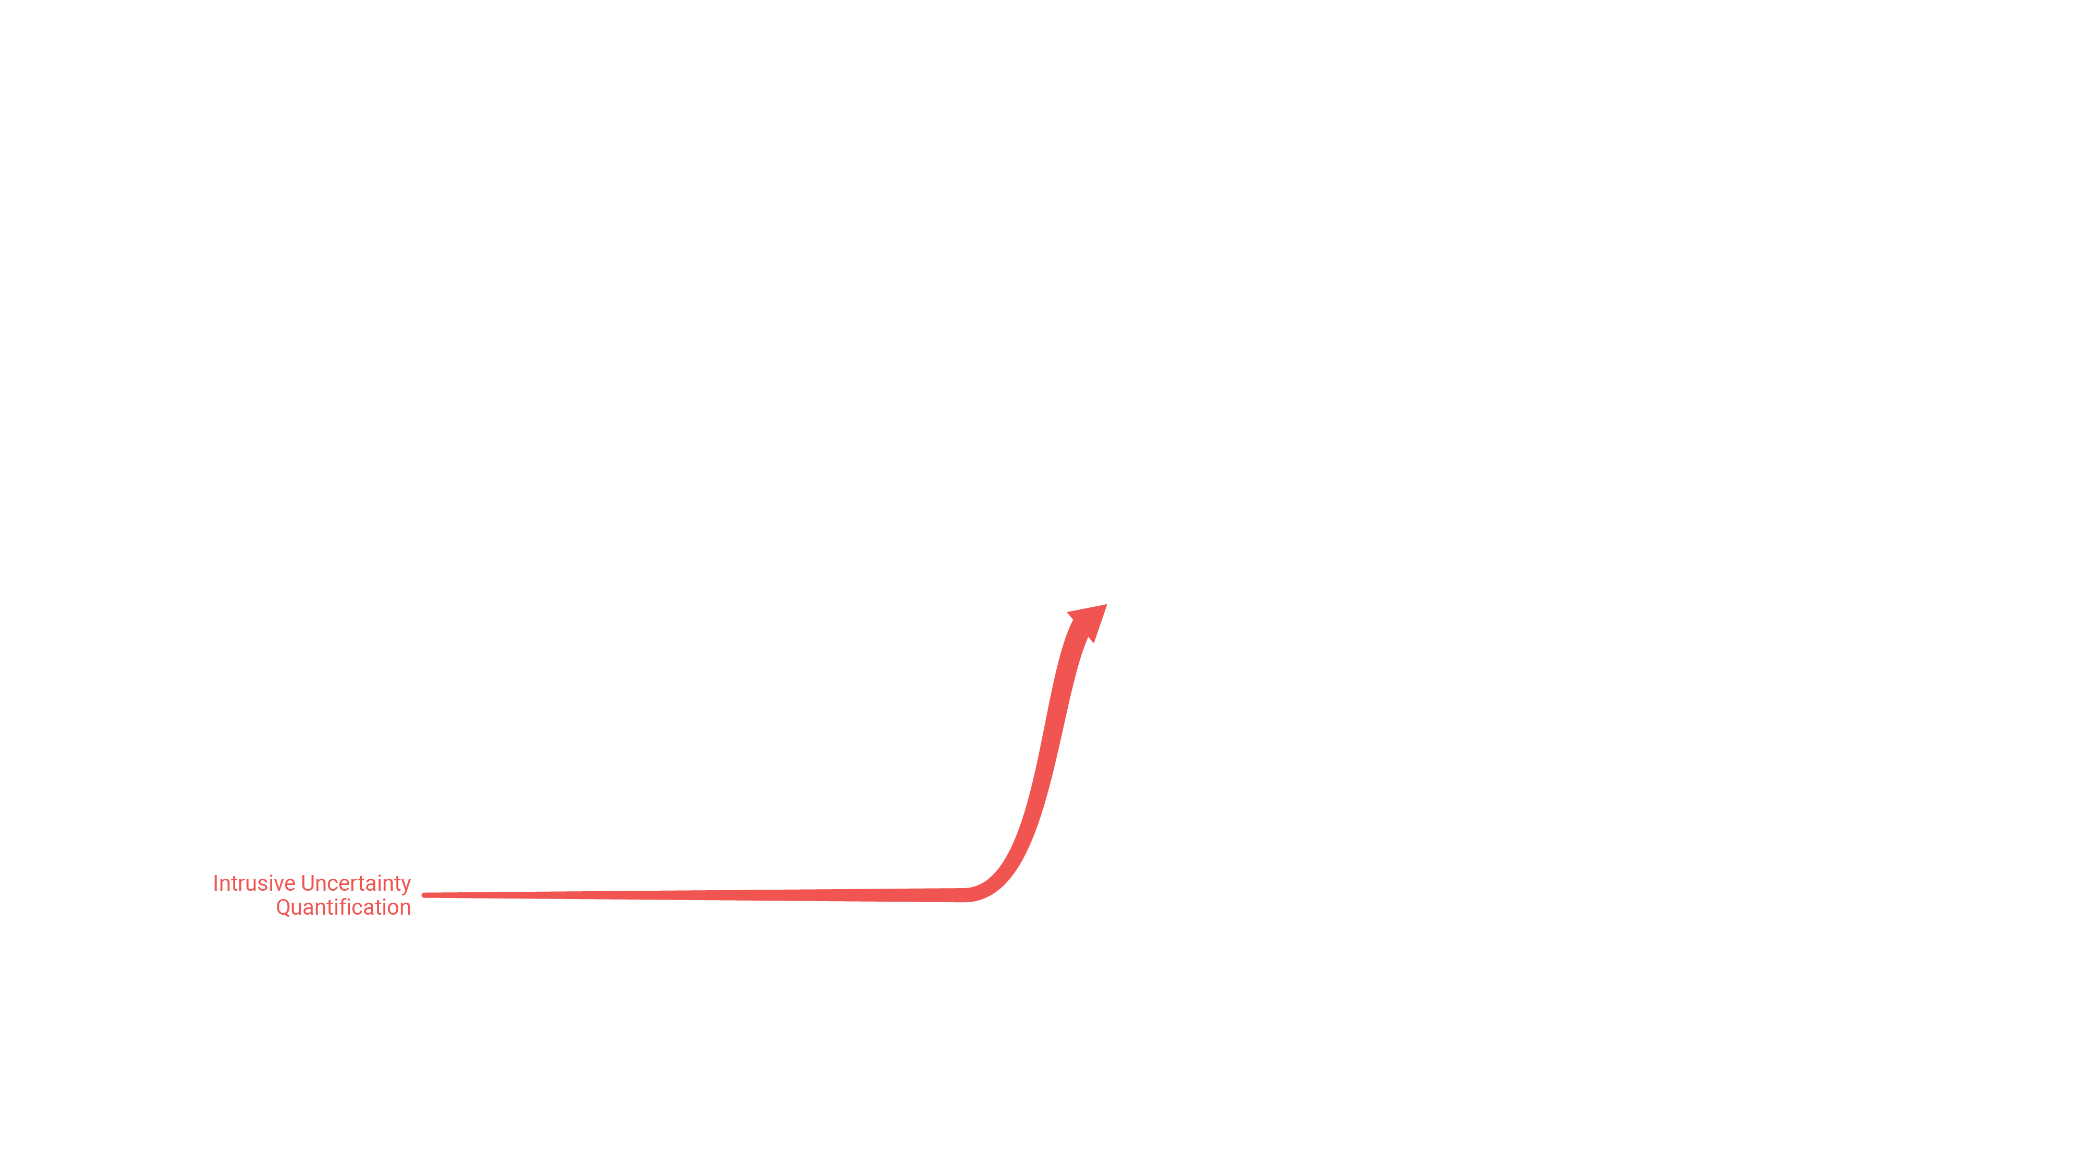
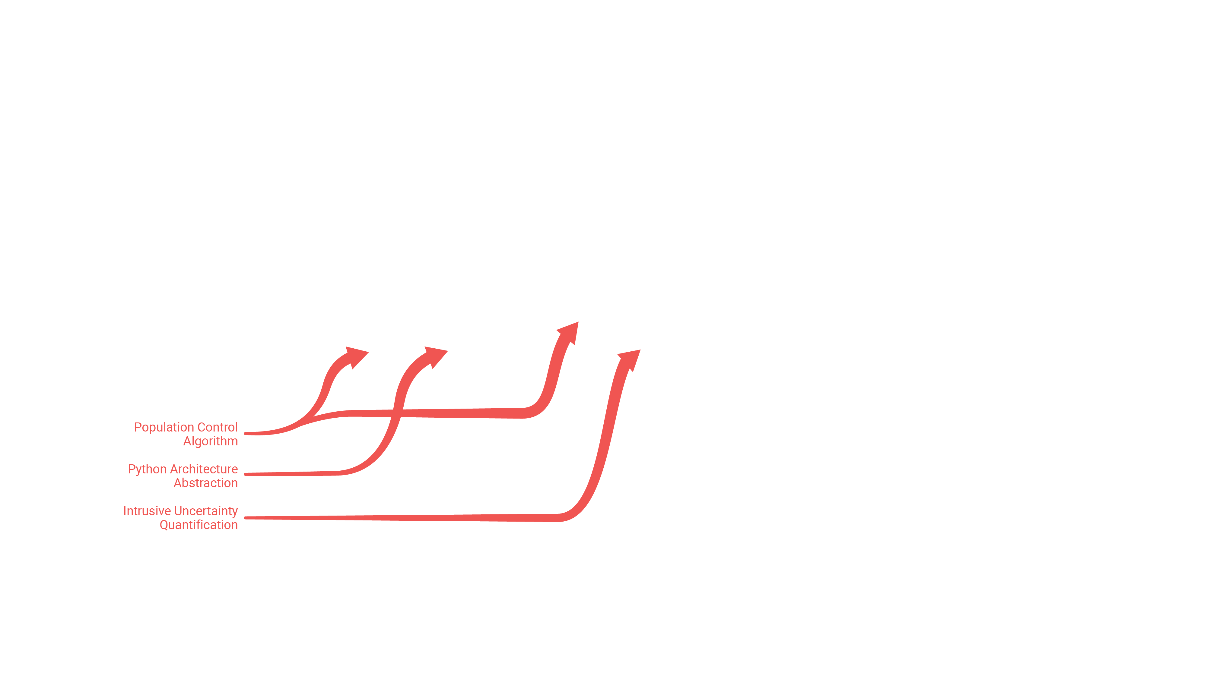

Roadmap

Slide 4
Summary: Variance Deconvolution
Variance Deconvolution (Var-D) is a Monte Carlo UQ method for stochastic solvers (e.g., Monte Carlo radiation transport)
Monte Carlo UQ is robust and dimension-independent
Var-D accurately estimates the variance induced by uncertain parameters by explicitly computing and removing the solver variance

Slide 5
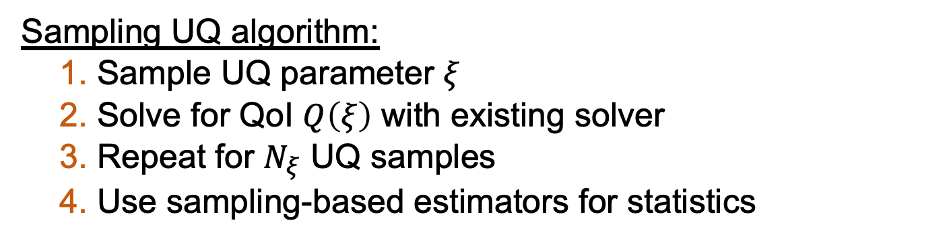
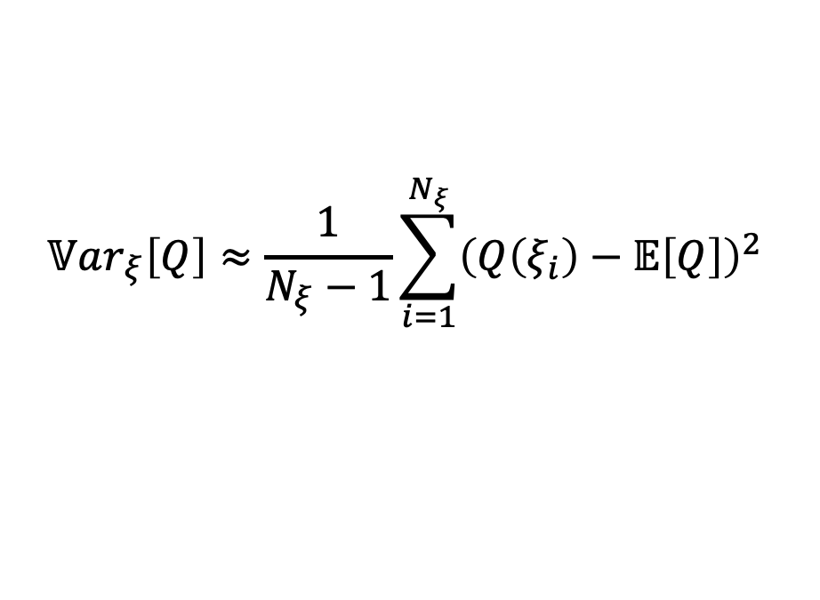
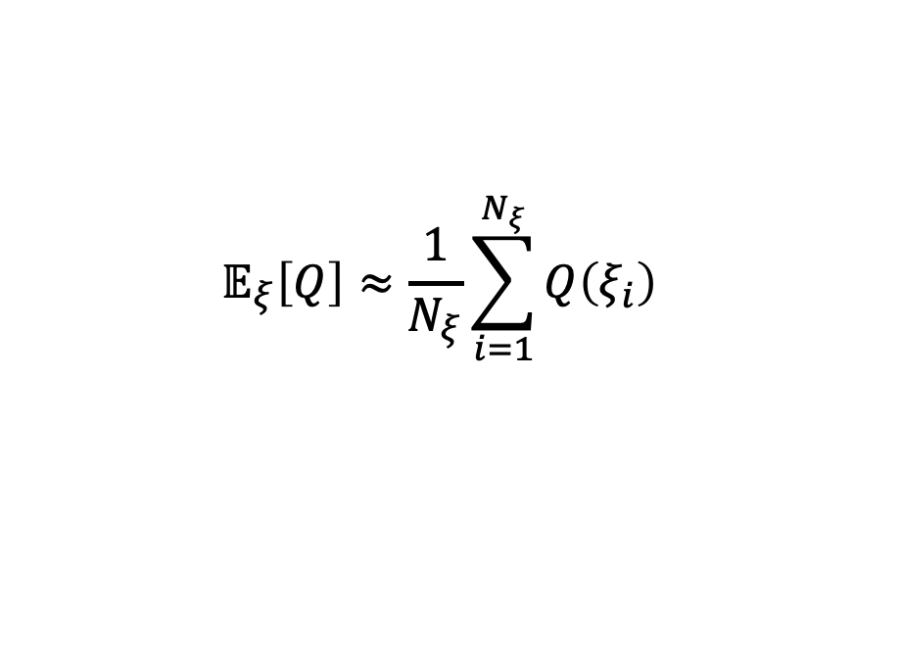
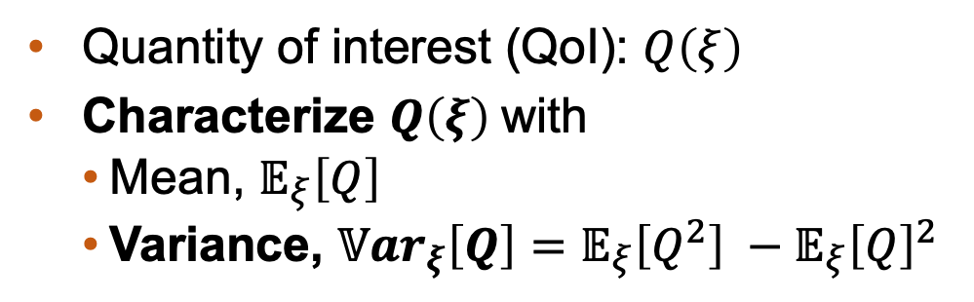
Background – Sampling uncertainty quantification
Quantity of interest (QoI): $Q\left(ξ\right)$
Characterize $Q\left(ξ\right)$with
Mean, $𝔼_{ξ}\left[Q\right]$
Variance, $𝕍ar_{ξ}\left[Q\right]=𝔼_{ξ}\left[Q^{2}\right] −𝔼_{ξ}{\left[Q\right]}^{2}$
$$𝔼_{ξ}\left[Q\right]≈\frac{1}{N_{ξ}}\sum_{i=1}^{N_{ξ}}{Q\left(ξ_{i}\right)}$$
$$𝕍ar_{ξ}\left[Q\right]≈\frac{1}{N_{ξ}−1}\sum_{i=1}^{N_{ξ}}{{\left(Q\left(ξ_{i}\right)−𝔼\left[Q\right]\right)}^{2}}$$
Sampling UQ algorithm:
Sample UQ parameter $ξ$
Solve for QoI $Q\left(ξ\right)$ with existing solver
Repeat for $N_{ξ}$ UQ samples
Use sampling-based estimators for statistics
Notes:
- an intro to uncertainty quantification
In general, quantity of interest Q, a function of uncertain parameter xi
UQ propagates some source of uncertainty through a numerical code to evaluate statistics
Statistics one might be interested in, using the moment equation. Mean is first moment; variance
You can use a variety of strategies, surrogate and sampling and hybrid
sampling aka MC good for noisy QoI, example alg
In general you have some quantity of interest (or QoI) Q as a result of a numerical code. Uncertainty quantification is the process of propagating some sources of uncertainty through the numerical code to evaluate the statistics of your QoI. Q is then a function of you uncertainty parameter, xi
We have an example here of some statistics of your QoI you might be interested in, as functions of the moment equation. So eq. 1 is the order-p moment equation of Q. Eq 2 is the first moment of Q, aka the expectation or mean. The variance can be taken to be the second moment minus the square of the first moment. A simple example of a stochastic system might look mathematically is eq. 4, where you have some differential equation describing your system, and the parameter xi represents uncertainty in your system.
There are a variety of UQ strategies – surrogates, sampling-based methods, or hybrids of the two. In general, sampling methods (aka MC methods) are good for systems with noisy quantities of interest. Applied to eq. 4, If you have a numerical solver for a solution of y, a sampling UQ approach would be to sample xi and solve for y as a function of it, then do that a number of times (this is referred to as Monte Carlo UQ). Then, calculate your statistics information to understand how your QoI reacts as a function of this uncertain parameter, and we can compare to an exact solution to understand how accurate our sampling approach is.

Slide 6
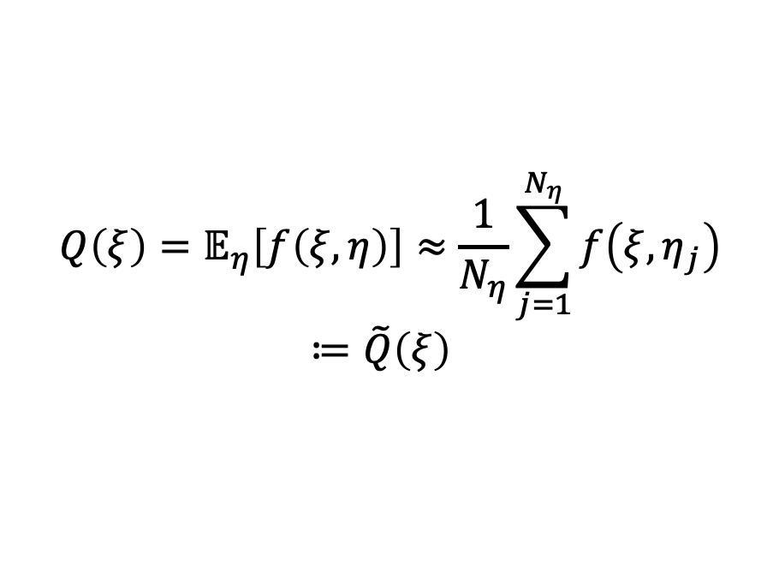
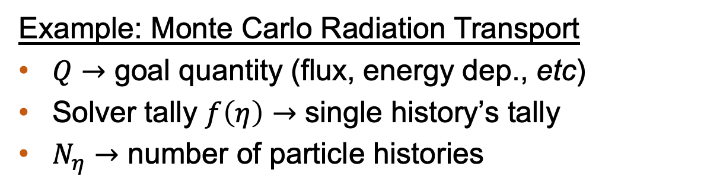
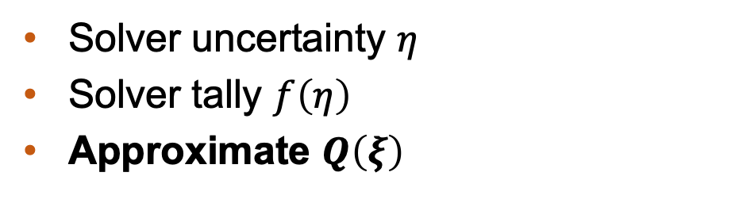
Background – Stochastic solvers
Solver uncertainty $η$
Solver tally $f\left(η\right)$
Approximate $Q\left(ξ\right)$
$$Q\left(ξ\right)=𝔼_{η}\left[f\left(ξ, η\right)\right]≈\frac{1}{N_{η}}\sum_{j=1}^{N_{η}}{f\left({ξ,η}_{j}\right)}≔\tilde{Q}\left(ξ\right)$$
Example: Monte Carlo Radiation Transport
$Q→$ goal quantity (flux, energy dep., etc)
Solver tally $f\left(η\right)→$ single history’s tally
$N_{η}→$ number of particle histories
Notes:
- an intro to uncertainty quantification
In general, quantity of interest Q, a function of uncertain parameter xi
UQ propagates some source of uncertainty through a numerical code to evaluate statistics
Statistics one might be interested in, using the moment equation. Mean is first moment; variance
You can use a variety of strategies, surrogate and sampling and hybrid
sampling aka MC good for noisy QoI, example alg
In general you have some quantity of interest (or QoI) Q as a result of a numerical code. Uncertainty quantification is the process of propagating some sources of uncertainty through the numerical code to evaluate the statistics of your QoI. Q is then a function of you uncertainty parameter, xi
We have an example here of some statistics of your QoI you might be interested in, as functions of the moment equation. So eq. 1 is the order-p moment equation of Q. Eq 2 is the first moment of Q, aka the expectation or mean. The variance can be taken to be the second moment minus the square of the first moment. A simple example of a stochastic system might look mathematically is eq. 4, where you have some differential equation describing your system, and the parameter xi represents uncertainty in your system.
There are a variety of UQ strategies – surrogates, sampling-based methods, or hybrids of the two. In general, sampling methods (aka MC methods) are good for systems with noisy quantities of interest. Applied to eq. 4, If you have a numerical solver for a solution of y, a sampling UQ approach would be to sample xi and solve for y as a function of it, then do that a number of times (this is referred to as Monte Carlo UQ). Then, calculate your statistics information to understand how your QoI reacts as a function of this uncertain parameter, and we can compare to an exact solution to understand how accurate our sampling approach is.

Slide 7
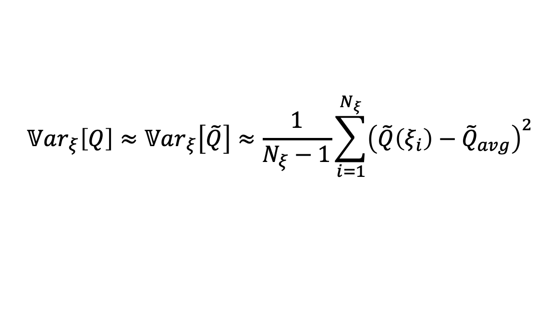
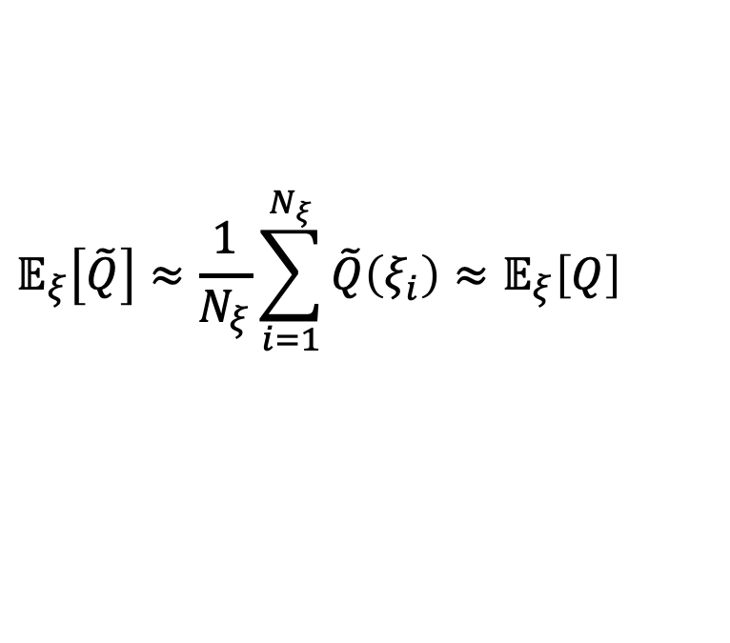
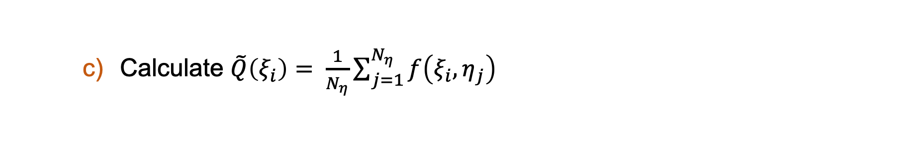
Brute-Force Attempt
Stochastic parameter $ξ$ that influences output $Q$
For i = 1:$N_{ξ}$
Sample $ξ$
Run radiation transport simulation with $N_{η}$particles
Calculate $\tilde{Q}\left(ξ_{i}\right)= \frac{1}{N_{η}}\sum_{j=1}^{N_{η}}{f\left(ξ_{i}, η_{j}\right) }$
Approximate mean over UQ space
$$𝔼_{ξ}\left[\tilde{Q}\right]≈\frac{1}{N_{ξ}}\sum_{i=1}^{N_{ξ}}{\tilde{Q}\left(ξ_{i}\right)}≈𝔼_{ξ}\left[Q\right]$$
Approximate variance over UQ space
$$𝕍ar_{ξ}\left[Q\right]≈𝕍ar_{ξ}\left[\tilde{Q}\right]≈\frac{1}{N_{ξ}−1}\sum_{i=1}^{N_{ξ}}{{\left(\tilde{Q}\left(ξ_{i}\right)−{\tilde{Q}}_{avg}\right)}^{2}}$$
Notes:
Set parameters
For each UQ sample, sample xi and get sigT
Run RT solver for N_eta histories, tally response f
Calculate T-tilde by averaging all tallies for this sample
Calculate variance of tallies for this sample
Once repeated for all samples, avg MC noise over param space aka solver
Also calculate variance of T-tilde over param space aka total
Subtract solver from total for parametric variance in UQ space
*click* for each UQ sample, calculate sigmaT, then run mc simulations with N_eta number of histories, each of which has a tally response f.
Calculate the average transmittance for this UQ sample T-tilde, and the variance of the tally responses for this UQ sample
Once the loop over N_xi is complete, we can calculate the average sig_eta_sq over the entire UQ space, the variance of T-tildes over the UQ space, and then the parametric variance var T.

Slide 8

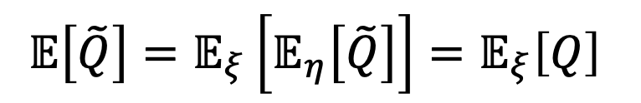
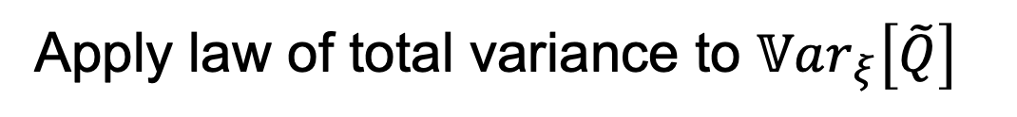
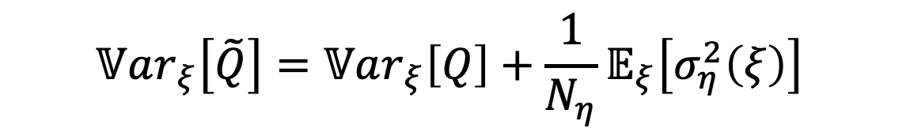
Variance Deconvolution
$$𝔼\left[\tilde{Q}\right]=𝔼_{ξ}\left[𝔼_{η}\left[\tilde{Q}\right]\right]=𝔼_{ξ}\left[Q\right]$$
Apply law of total variance to $𝕍ar_{ξ}\left[\tilde{Q}\right]$
Goal: Parametric variance
$$𝕍ar_{ξ}\left[\tilde{Q}\right]=𝕍ar_{ξ}\left[Q\right]+\frac{1}{N_{η}}𝔼_{ξ}\left[σ_{η}^{2}\left(ξ\right)\right]$$
Accessible: Total variance
Accessible: Average MCRT solver variance
Notes:
- an intro to uncertainty quantification
In general, quantity of interest Q, a function of uncertain parameter xi
UQ propagates some source of uncertainty through a numerical code to evaluate statistics
Statistics one might be interested in, using the moment equation. Mean is first moment; variance
You can use a variety of strategies, surrogate and sampling and hybrid
sampling aka MC good for noisy QoI, example alg
In general you have some quantity of interest (or QoI) Q as a result of a numerical code. Uncertainty quantification is the process of propagating some sources of uncertainty through the numerical code to evaluate the statistics of your QoI. Q is then a function of you uncertainty parameter, xi
We have an example here of some statistics of your QoI you might be interested in, as functions of the moment equation. So eq. 1 is the order-p moment equation of Q. Eq 2 is the first moment of Q, aka the expectation or mean. The variance can be taken to be the second moment minus the square of the first moment. A simple example of a stochastic system might look mathematically is eq. 4, where you have some differential equation describing your system, and the parameter xi represents uncertainty in your system.
There are a variety of UQ strategies – surrogates, sampling-based methods, or hybrids of the two. In general, sampling methods (aka MC methods) are good for systems with noisy quantities of interest. Applied to eq. 4, If you have a numerical solver for a solution of y, a sampling UQ approach would be to sample xi and solve for y as a function of it, then do that a number of times (this is referred to as Monte Carlo UQ). Then, calculate your statistics information to understand how your QoI reacts as a function of this uncertain parameter, and we can compare to an exact solution to understand how accurate our sampling approach is.

Slide 9
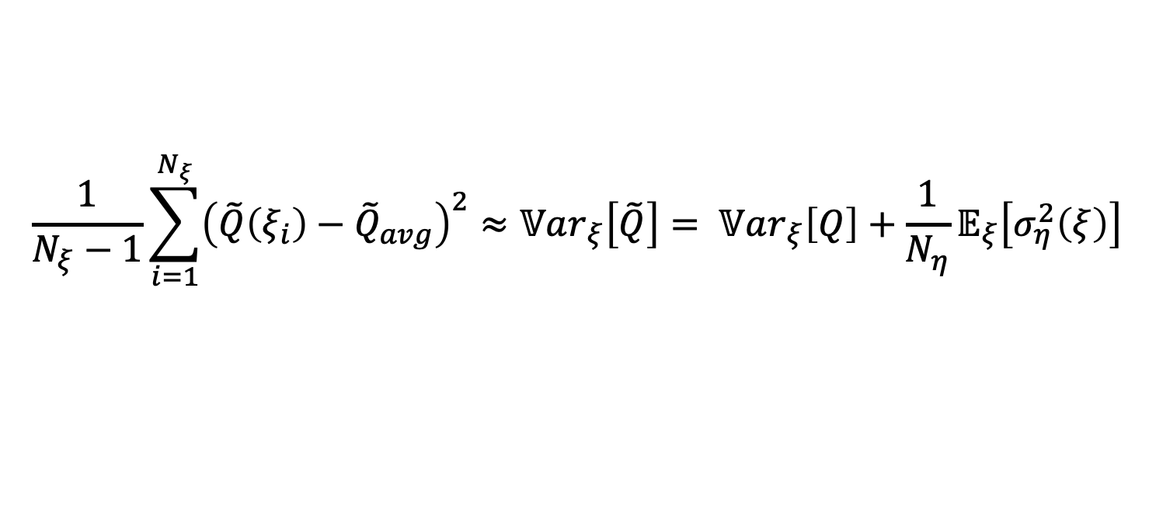
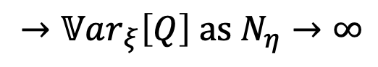
Brute-Force Result
Stochastic parameter $ξ$ that influences output $Q$
For i = 1:$N_{ξ}$
Sample $ξ$
Run radiation transport simulation with $N_{η}$particles
Calculate $\tilde{Q}\left(ξ_{i}\right)= \frac{1}{N_{η}}\sum_{j=1}^{N_{η}}{f\left(ξ_{i}, η_{j}\right) }$
Approximate mean over UQ space
$$𝔼_{ξ}\left[\tilde{Q}\right]≈\frac{1}{N_{ξ}}\sum_{i=1}^{N_{ξ}}{\tilde{Q}\left(ξ_{i}\right)}≈𝔼_{ξ}\left[Q\right]$$
Approximate variance over UQ space
$$\frac{1}{N_{ξ}−1}\sum_{i=1}^{N_{ξ}}{{\left(\tilde{Q}\left(ξ_{i}\right)−{\tilde{Q}}_{avg}\right)}^{2}}≈𝕍ar_{ξ}\left[\tilde{Q}\right]= 𝕍ar_{ξ}\left[Q\right]+\frac{1}{N_{η}}𝔼_{ξ}\left[σ_{η}^{2}\left(ξ\right)\right]$$
$→𝕍ar_{ξ}\left[Q\right] as N_{η}→∞$
Notes:
Set parameters
For each UQ sample, sample xi and get sigT
Run RT solver for N_eta histories, tally response f
Calculate T-tilde by averaging all tallies for this sample
Calculate variance of tallies for this sample
Once repeated for all samples, avg MC noise over param space aka solver
Also calculate variance of T-tilde over param space aka total
Subtract solver from total for parametric variance in UQ space
*click* for each UQ sample, calculate sigmaT, then run mc simulations with N_eta number of histories, each of which has a tally response f.
Calculate the average transmittance for this UQ sample T-tilde, and the variance of the tally responses for this UQ sample
Once the loop over N_xi is complete, we can calculate the average sig_eta_sq over the entire UQ space, the variance of T-tildes over the UQ space, and then the parametric variance var T.

Slide 10
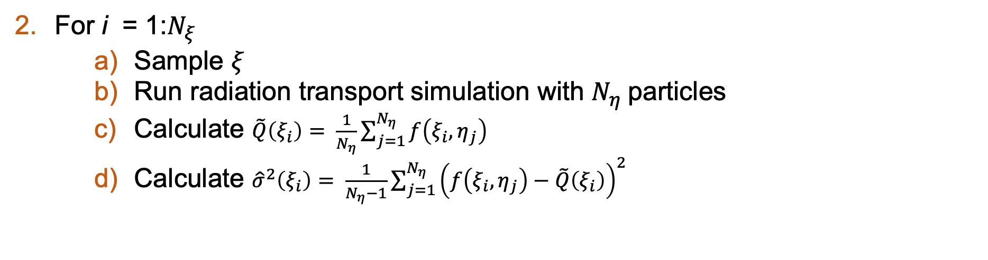
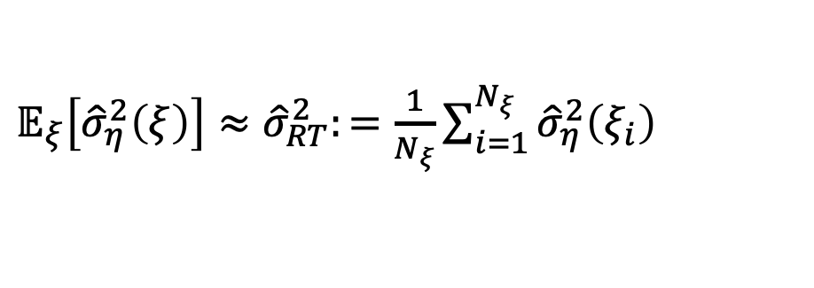
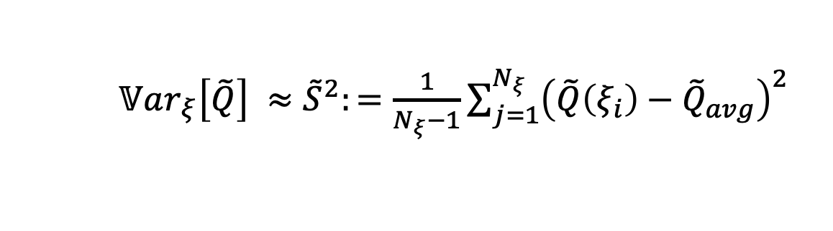
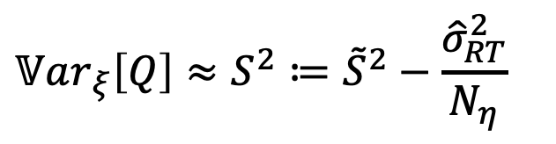
Variance Deconvolution Approach
Stochastic parameter $ξ$ that influences output $Q$
For i = 1:$N_{ξ}$
Sample $ξ$
Run radiation transport simulation with $N_{η}$particles
Calculate $\tilde{Q}\left(ξ_{i}\right)= \frac{1}{N_{η}}\sum_{j=1}^{N_{η}}{f\left(ξ_{i}, η_{j}\right) }$
Calculate ${\hat{σ}}^{2}\left(ξ_{i}\right)= \frac{1}{N_{η}−1}\sum_{j=1}^{N_{η}}{{\left(f\left(ξ_{i}, η_{j}\right)−\tilde{Q}\left(ξ_{i}\right)\right)}^{2} }$
Now an MC/DC feature!
Calculate average MCRT solver noise:
$𝔼_{ξ}\left[{\hat{σ}}_{η}^{2}\left(ξ\right)\right]≈{\hat{σ}}_{RT}^{2}:=\frac{1}{N_{ξ}}\sum_{i=1}^{N_{ξ}}{{\hat{σ}}_{η}^{2}\left(ξ_{i}\right) }$
Calculate total variance:
$𝕍ar_{ξ}\left[\tilde{Q}\right] ≈{\tilde{S}}^{2}:=\frac{1}{N_{ξ}−1}\sum_{j=1}^{N_{ξ}}{{\left(\tilde{Q}\left(ξ_{i}\right)−{\tilde{Q}}_{avg}\right)}^{2}}$
Solve for parametric variance:
$$𝕍ar_{ξ}\left[Q\right]≈S^{2}≔{\tilde{S}}^{2}−\frac{{\hat{σ}}_{RT}^{2}}{N_{η}}$$
Notes:
Set parameters
For each UQ sample, sample xi and get sigT
Run RT solver for N_eta histories, tally response f
Calculate T-tilde by averaging all tallies for this sample
Calculate variance of tallies for this sample
Once repeated for all samples, avg MC noise over param space aka solver
Also calculate variance of T-tilde over param space aka total
Subtract solver from total for parametric variance in UQ space
*click* for each UQ sample, calculate sigmaT, then run mc simulations with N_eta number of histories, each of which has a tally response f.
Calculate the average transmittance for this UQ sample T-tilde, and the variance of the tally responses for this UQ sample
Once the loop over N_xi is complete, we can calculate the average sig_eta_sq over the entire UQ space, the variance of T-tildes over the UQ space, and then the parametric variance var T.

Slide 11
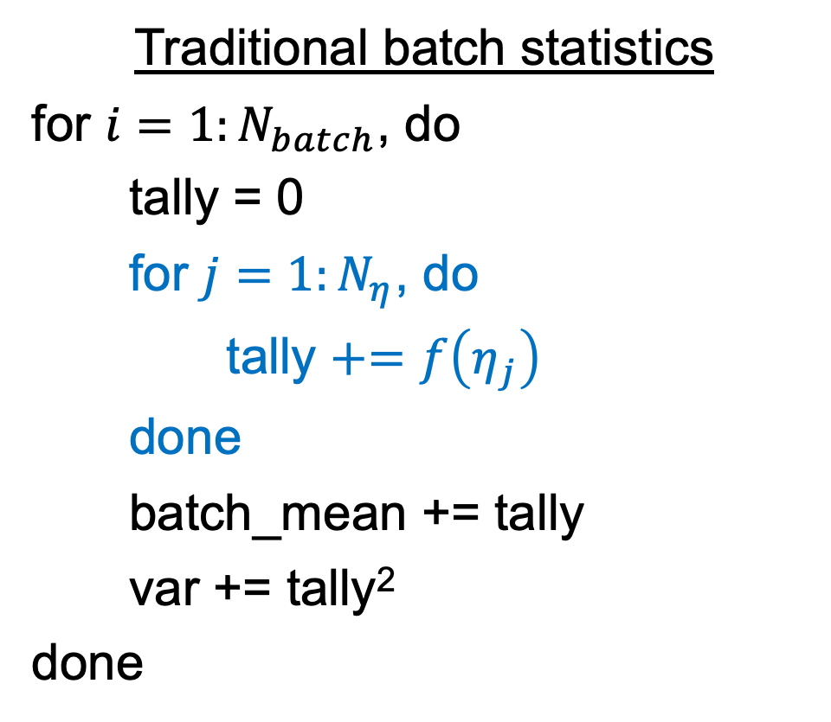
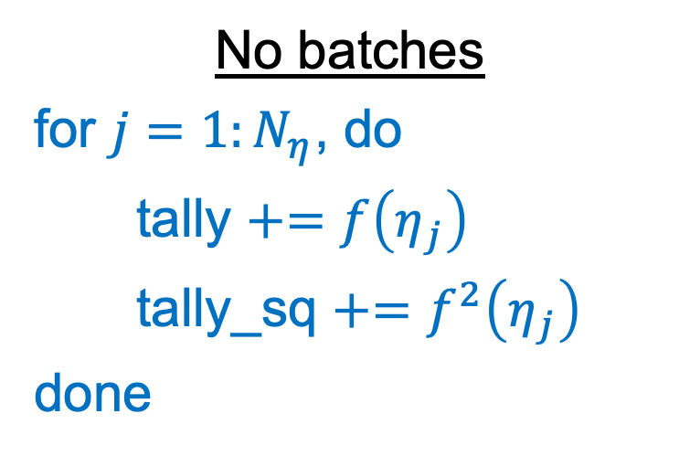
Batches in MC/DC
No batches
for $j=1:N_{η}$, do
tally $+=f\left(η_{j}\right)$
tally_sq $+=f^{2}\left(η_{j}\right)$
done
Traditional batch statistics
for $i=1:N_{batch}$, do
tally = 0
for $j=1:N_{η}$, do
tally $+=f\left(η_{j}\right)$
done
batch_mean += tally
var += tally²
done
Var-D requires adding tally_sq back into batch loop

Slide 12
Random seeding in MC/DC
Desire random seeding reproducibility on parallel computers regardless of architecture of number of processors
Consistent across batches and particle histories
MC/DC uses Random Number Generation with Arbitrary Strides introduced by Brown in 1994, implemented in MC/DC by Ilham Variansyah and Braxton Cuneo [1]

Slide 13
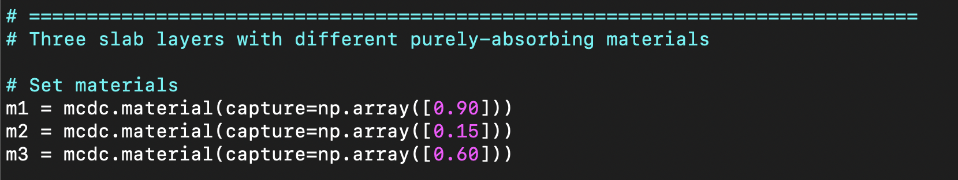
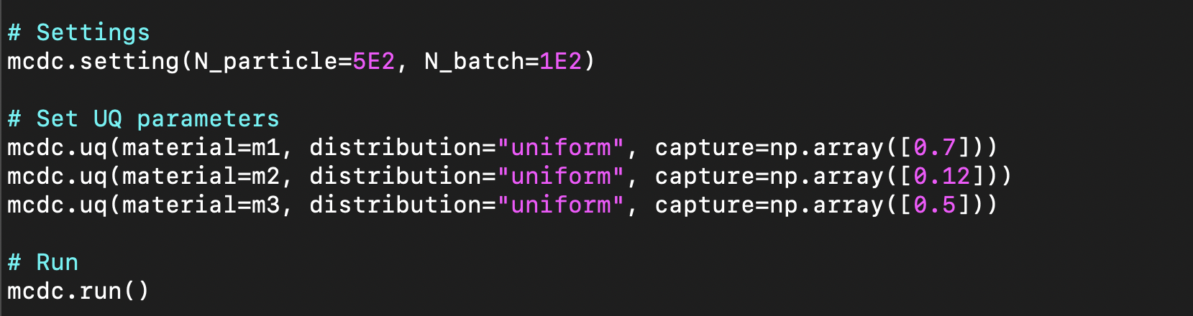
Implementation in MC/DC
MC/DC input file:
Parameter mean
Parameter deviation

Slide 14
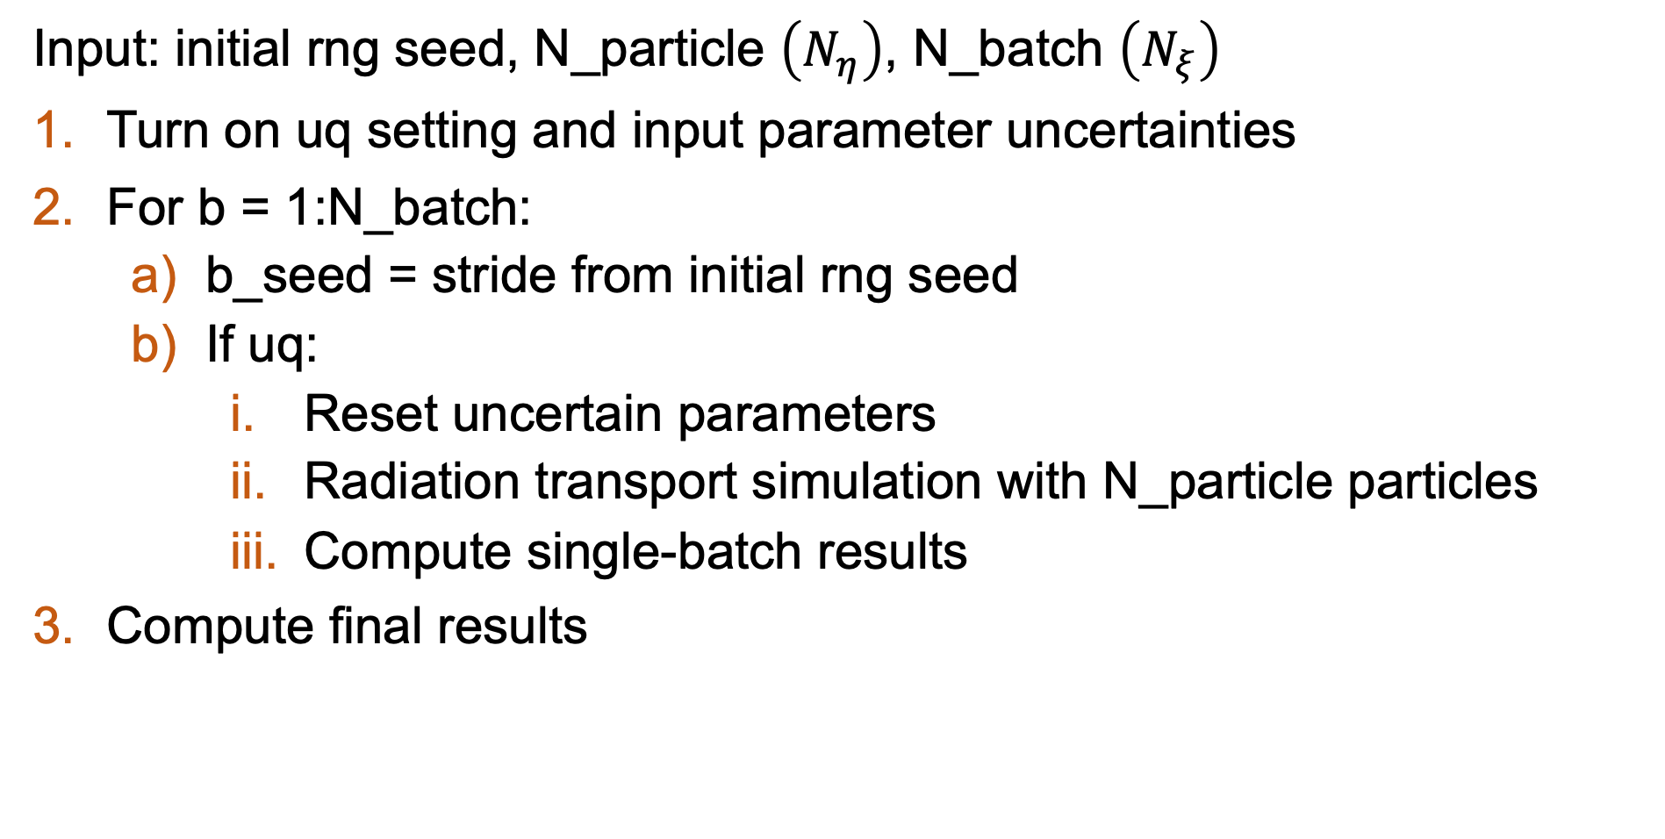
Implementation in MC/DC
Input: initial rng seed, N_particle $\left(N_{η}\right)$, N_batch $\left(N_{ξ}\right)$
Turn on uq setting and input parameter uncertainties
For b = 1:N_batch:
b_seed = stride from initial rng seed
If uq:
Reset uncertain parameters
Radiation transport simulation with N_particle particles
Compute single-batch results
Compute final results
Parallel in MC/DC using MPI

Slide 15


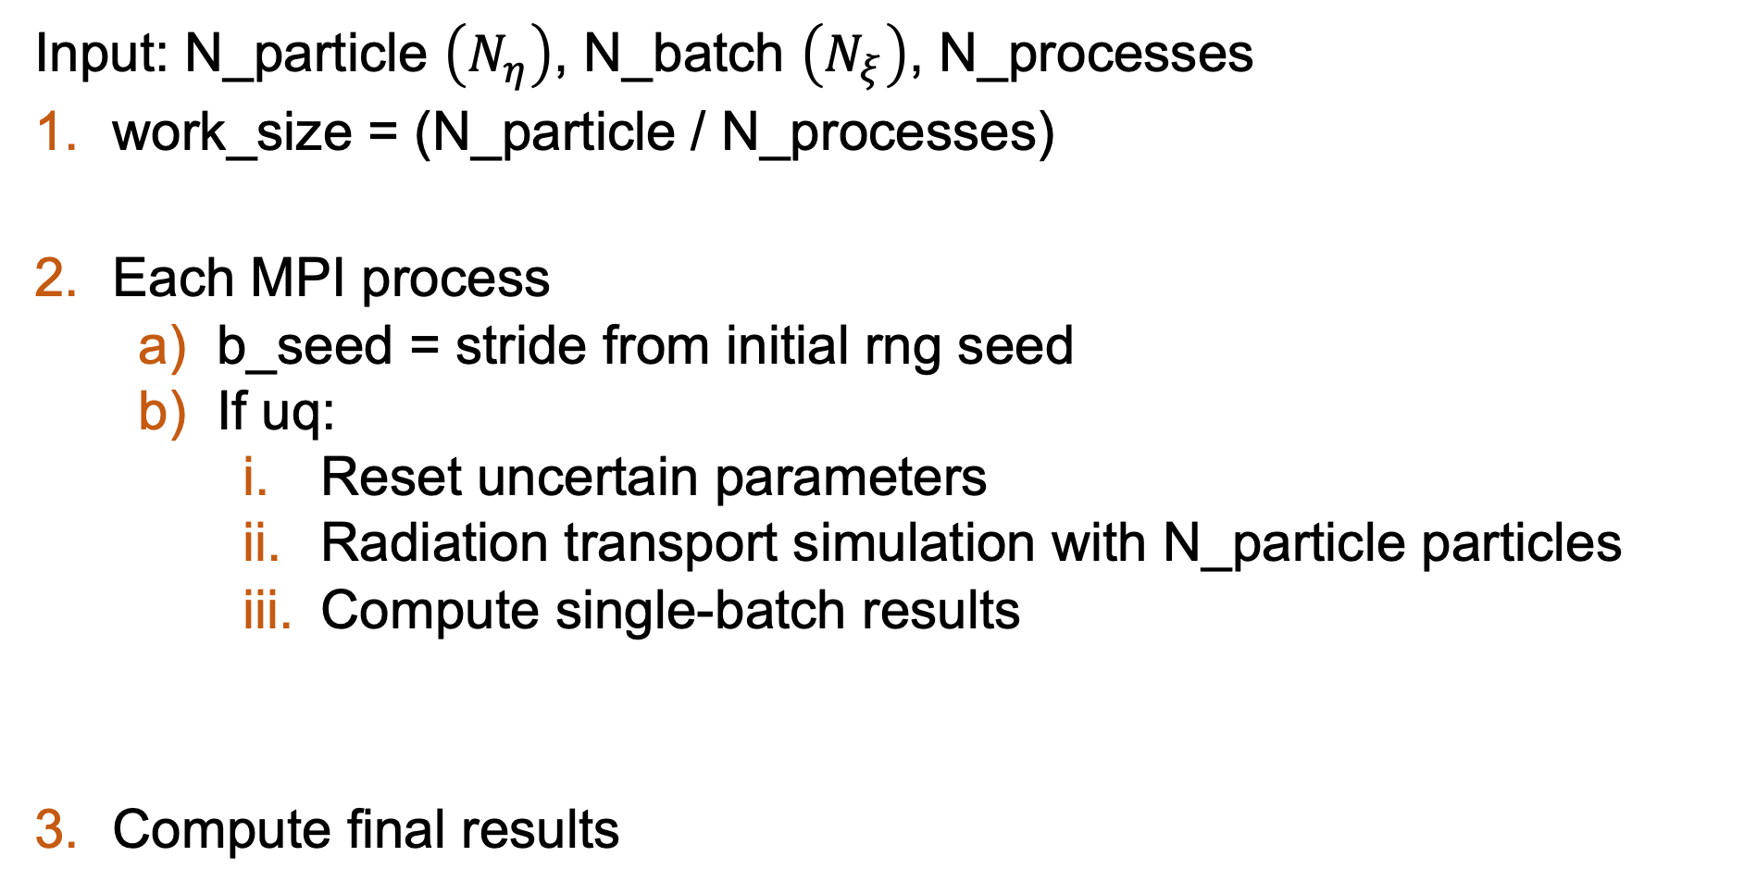
Parallelism in MC/DC (simplified)
Input: N_particle $\left(N_{η}\right)$, N_batch $\left(N_{ξ}\right)$, N_processes
work_size = (N_particle / N_processes)
Each MPI process
b_seed = stride from initial rng seed
If uq:
Reset uncertain parameters
Radiation transport simulation with N_particle particles
Compute single-batch results
Compute final results
For b = 1:N_batch, do
1. Radiation transport simulation with work_size particles
2. MPI.Reduce()
For b = 1:N_batch, do
1. Radiation transport simulation with work_size particles
2. MPI.Reduce()
Re-sample UQ parameters
Reproducible .
Efficient .

Slide 16
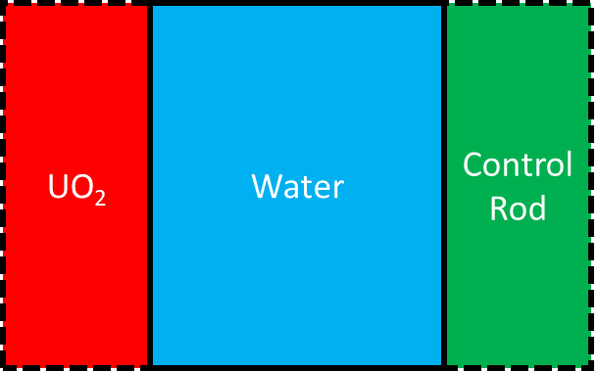

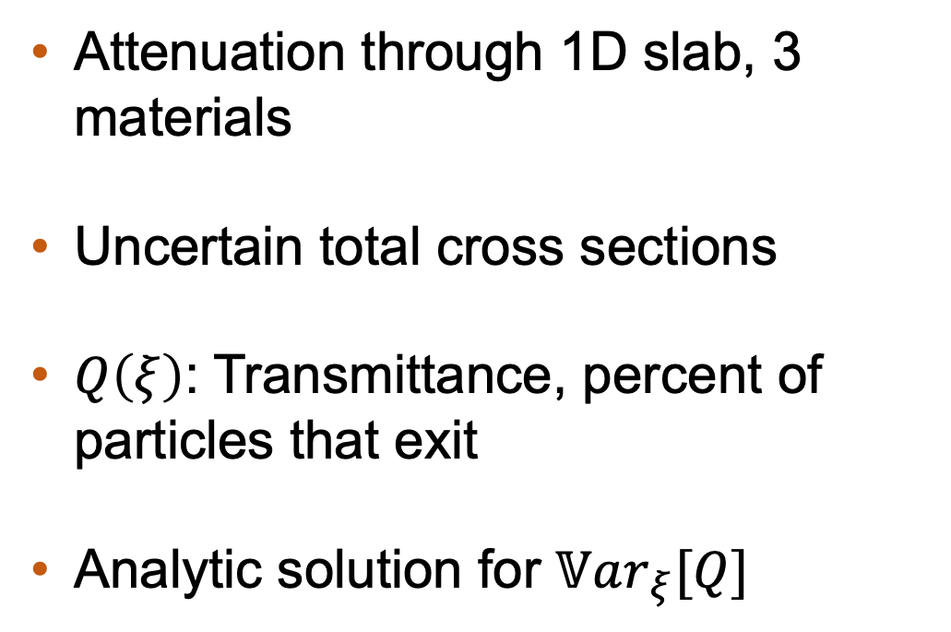
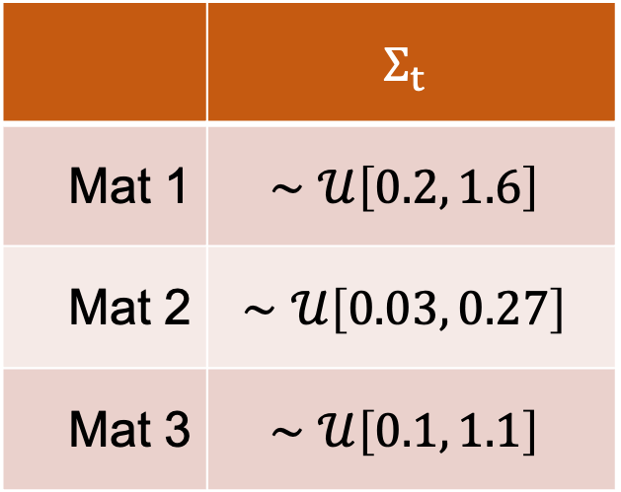
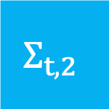
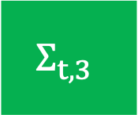
Example Problem – Visualize Motivations
$$Σ_{t,1}$$
$$Σ_{t,2}$$
$$Σ_{t,3}$$
Attenuation through 1D slab, 3 materials
Uncertain total cross sections
$Q\left(ξ\right)$: Transmittance, percent of particles that exit
Analytic solution for $𝕍ar_{ξ}[Q]$
 | $$Σ_{t}$$
Mat 1 | $$∼𝒰\left[0.2, 1.6\right]$$
Mat 2 | $$∼𝒰\left[0.03, 0.27\right]$$
Mat 3 | $$∼𝒰\left[0.1, 1.1\right]$$

Slide 17
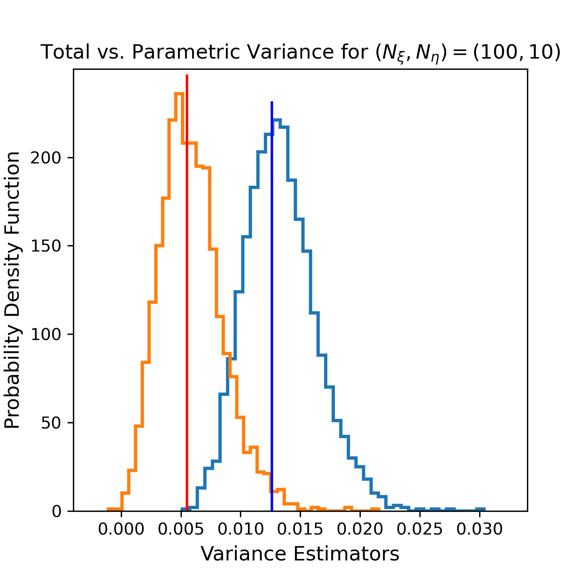
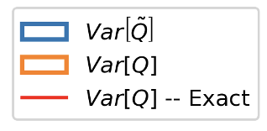
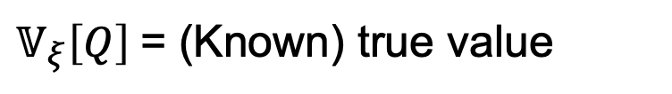
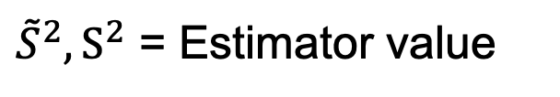
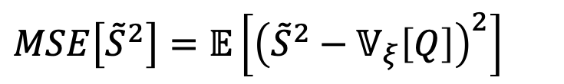
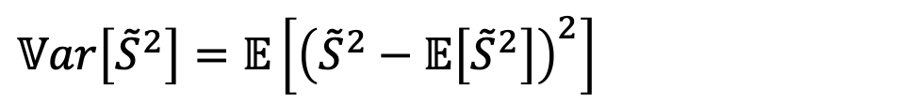
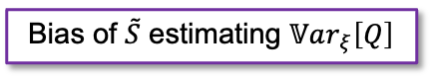
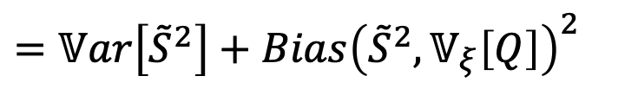
Example Problem – Visualize Motivations
${\tilde{S}}^{2},S^{2}$ = Estimator value
$𝕍_{ξ}\left[Q\right]$= (Known) true value
$$𝕍ar\left[{\tilde{S}}^{2}\right]=𝔼\left[{\left({\tilde{S}}^{2}−𝔼\left[{\tilde{S}}^{2}\right]\right)}^{2}\right]$$
$$MSE\left[{\tilde{S}}^{2}\right]=𝔼\left[{\left({\tilde{S}}^{2}−𝕍_{ξ}\left[Q\right]\right)}^{2}\right]$$
Bias of $\tilde{S}$ estimating $𝕍ar_{ξ}\left[Q\right]$
$$=𝕍ar\left[{\tilde{S}}^{2}\right]+Bias{\left({\tilde{S}}^{2},𝕍_{ξ}\left[Q\right]\right)}^{2}$$
Variances of estimators
Distribution of results over 25000 repetitions
Notes:
Table on the left shows the results for transmittance and parametric variance for a benchmark (overresolved) configuration, just one repetition (which is a sample), and the analytic results.
Repeated algorithm 25,000 times to get statistics of estimate of varT and varTtilde
300 Nxi 5 Neta
Clustered around analytic solution, estimators are unbiased
Strong indication that we get a good estimate of our variances
For a sample problem with 300 UQ samples and 5 particles per sample with 25,000 repetitions. Clustered around analytic solution, bc estimators are unbiased.

Slide 18
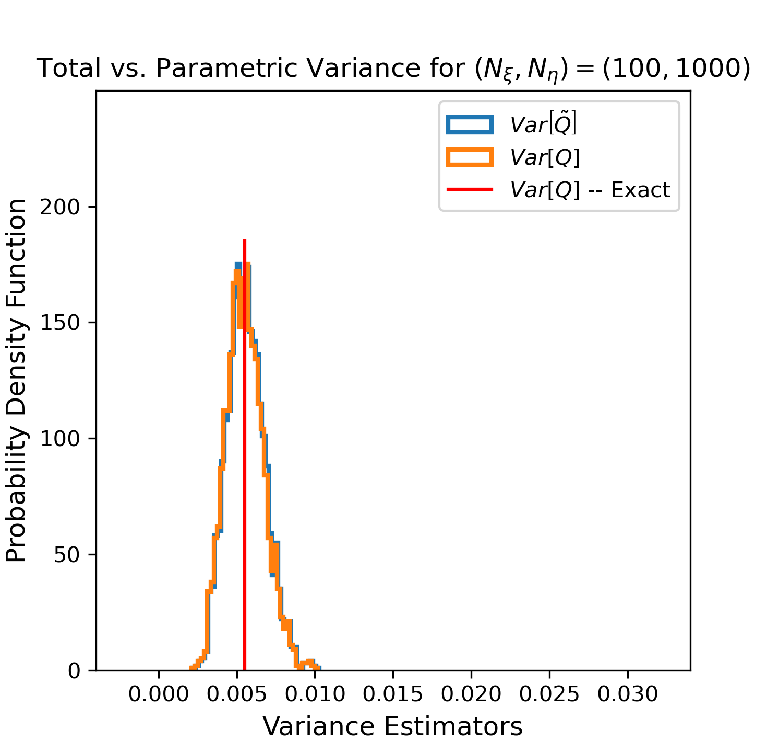
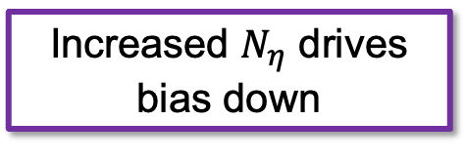
Example Problem – Visualize Motivations
Increased $N_{η}$ drives bias down
Notes:
Table on the left shows the results for transmittance and parametric variance for a benchmark (overresolved) configuration, just one repetition (which is a sample), and the analytic results.
Repeated algorithm 25,000 times to get statistics of estimate of varT and varTtilde
300 Nxi 5 Neta
Clustered around analytic solution, estimators are unbiased
Strong indication that we get a good estimate of our variances
For a sample problem with 300 UQ samples and 5 particles per sample with 25,000 repetitions. Clustered around analytic solution, bc estimators are unbiased.

Slide 19
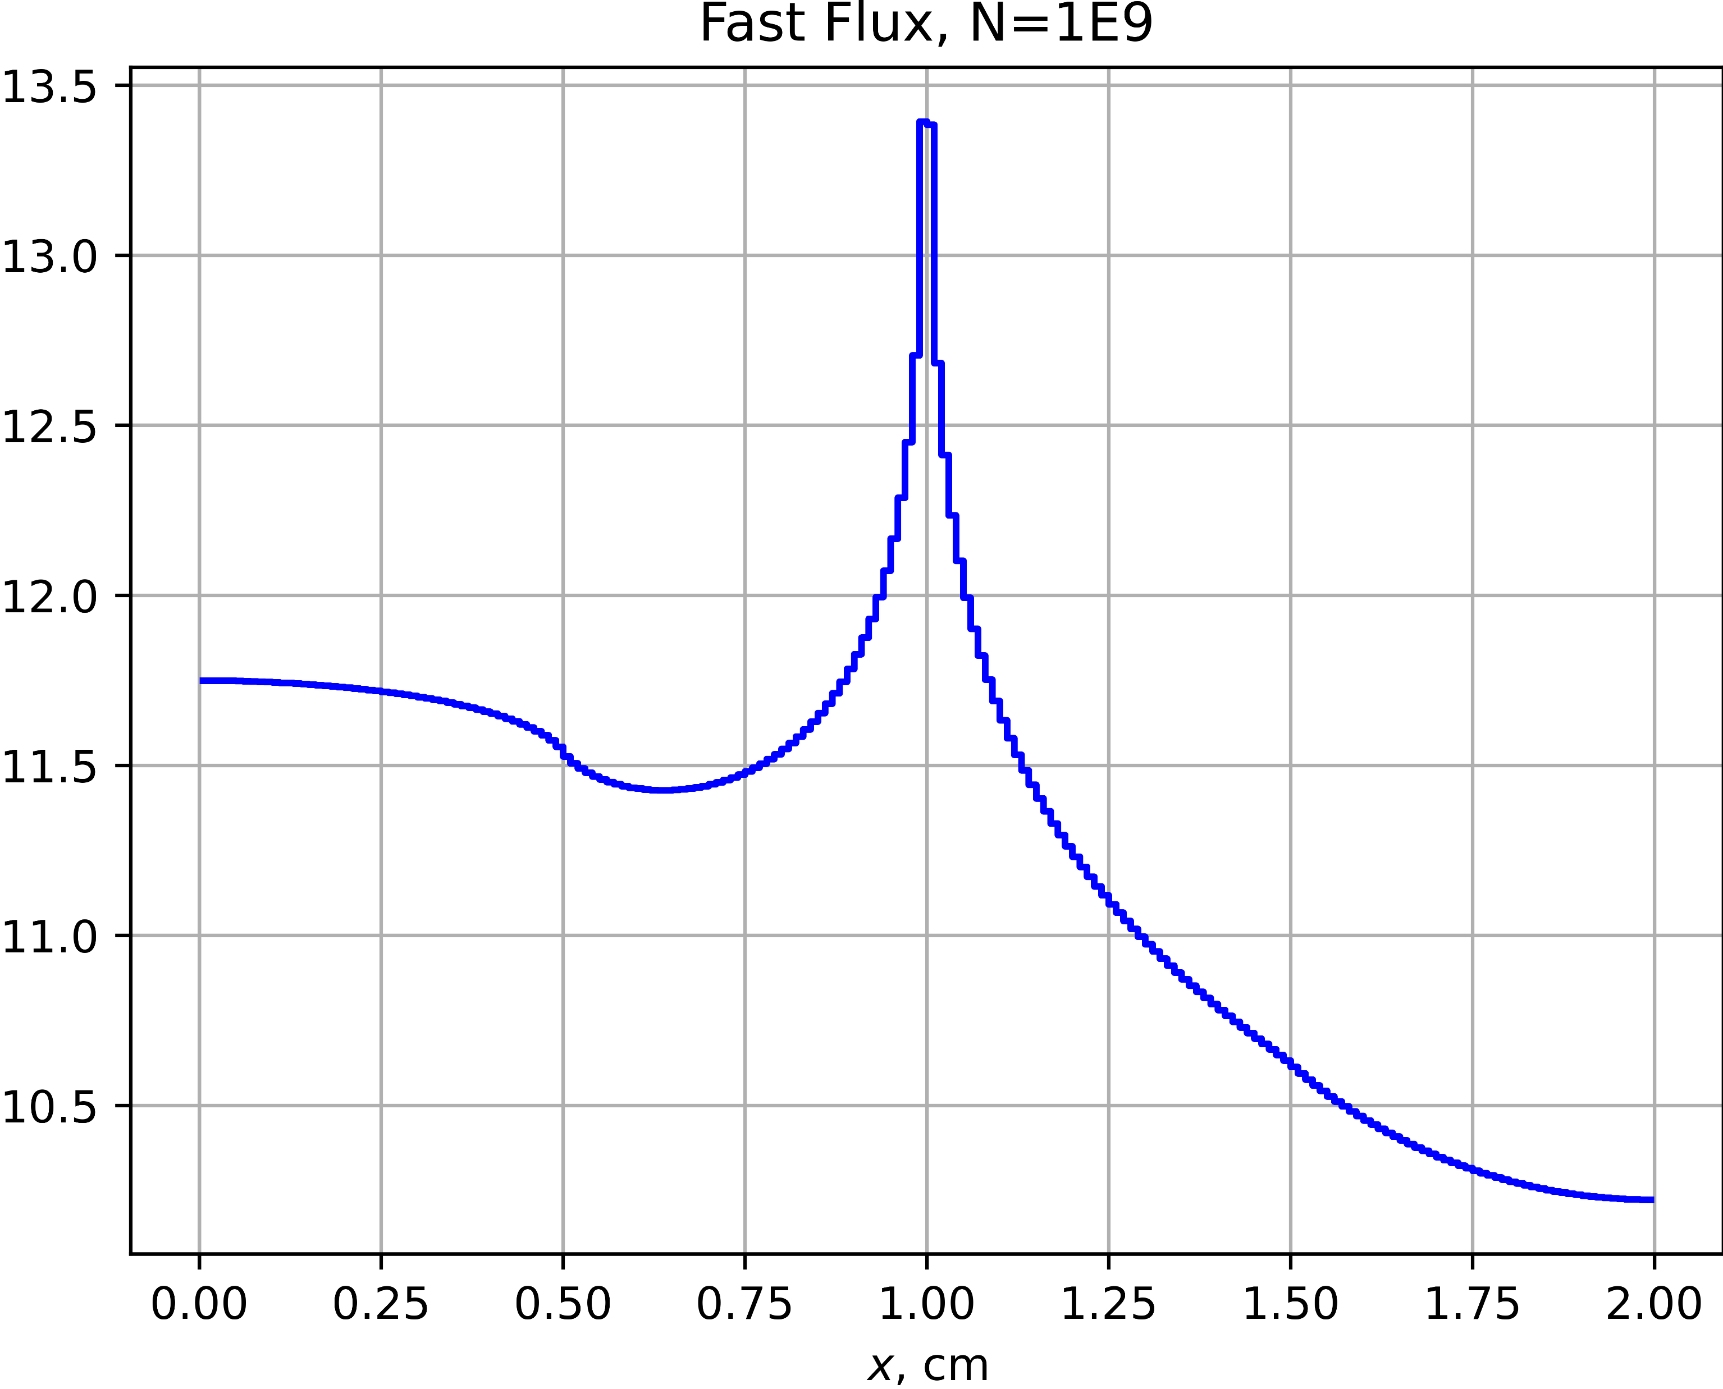
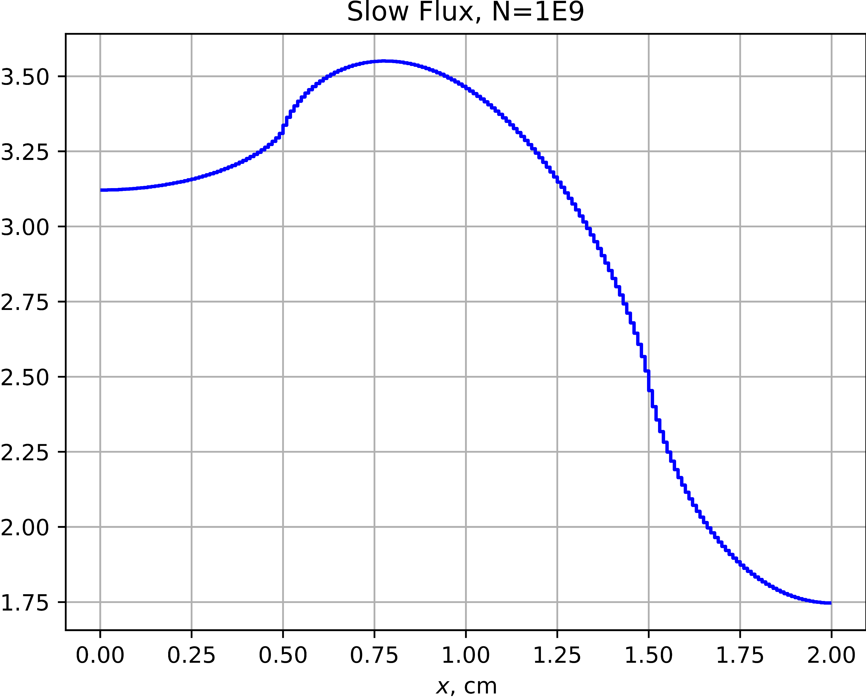
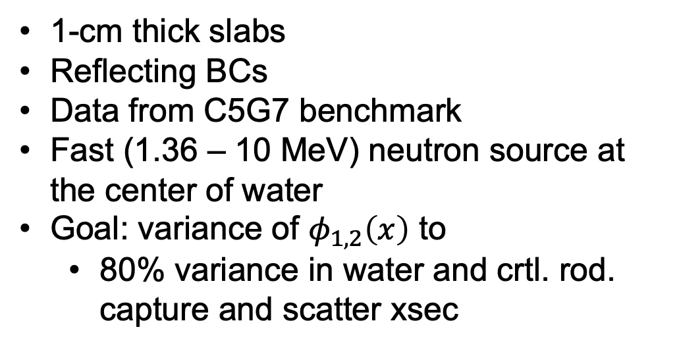
Infinite Slab Lattice Problem
Fast neutron flux
(9.2 keV – 10 MeV)
1-cm thick slabs
Reflecting BCs
Data from C5G7 benchmark
Fast (1.36 – 10 MeV) neutron source at the center of water
Goal: variance of $φ_{1,2}\left(x\right)$ to
80% variance in water and crtl. rod. capture and scatter xsec
Slow neutron flux
(< 9.2 keV)

Slide 20

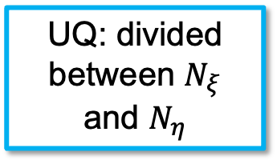


What is $σ_{η}^{2}$ without UQ?
$$𝕍ar_{ξ}\left[\tilde{Q}\right]=𝕍ar_{ξ}\left[Q\right]+\frac{1}{N_{η}}𝔼_{ξ}\left[σ_{η}^{2}\left(ξ\right)\right]$$
Brute force: $\frac{1}{N_{η}}𝔼_{ξ}\left[σ_{η}^{2}\left(ξ\right)\right]→0$ as $N_{η}→∞$
With no UQ, no batches:
UQ: divided between $N_{ξ}$ and $N_{η}$
$$N_{Total}$$ | $${\left\|\frac{σ^{2}}{N_{η}}\right\|}_{2}$$ | $${\left\|\frac{σ/\sqrt{N_{η}}}{\tilde{Q}}\right\|}_{2}$$
$${10}^{4}$$ | $${10}^{−3}$$ | $$0.36$$
$${10}^{5}$$ | $${10}^{−4}$$ | $$0.11$$
$${10}^{6}$$ | $${10}^{−5}$$ | $$0.04$$
$${10}^{7}$$ | $${10}^{−6}$$ | $$0.01$$
MCNP calls this R (rel. error)

Slide 21





Infinite Slab Lattice Problem
Reference solution $N_{η}={10}^{6}$, $N_{ξ}={10}^{4}$, $N_{Total}={10}^{10}$
Var-D and brute force $N_{η}={10}^{2}$, $N_{ξ}={10}^{4}$, $N_{Total}={10}^{6}$
QoI: Cell-avg $φ_{1}$
QoI: Cell-avg $φ_{2}$
Var-D consistently out-performs brute force

Slide 22





Error and Figure of Merit
Figure of Merit
$$\text{FOM}=\frac{1}{ε^{2}T}$$
Reference solution: $N_{η}={10}^{6}, N_{ξ}={10}^{4}$
Constant $N_{Total}$
Increasing $N_{η}→$ decreasing $N_{ξ}$
Run without MPI (i.e., serially)
$T$: Runtime
$ε$: rel. error (2-norm)
Relative error
Var-D shows efficiency tradeoff between N_particle and N_batch
FOM

Slide 23
Future Considerations
Uncertainty quantification: Variance deconvolution
Duplicated previous (non-MC/DC) results
Tested 7-group problem with fission (c5g7-like infinite lattice)
Supported parameters: material and nuclide cross sections, surface position
Supports MPI parallelization over particle histories
Near-term development:
Batch parallelization
Additional parameter support (material nuclide densities)
k_{eff} as a QoI
Scaling studies: performance on problems that require computing resources approaching exascale

